Slide 1
TERM 4
English
GRADE 2 YEAR 1

Slide 2
LESSON PLAN CONTENT
WEEK 1-2 | WATER
WEEK 3-5 | OUR COUNTRY SOUTH AFRICA
WEEK 6-7 | COMMUNICATION IN OUR WORLD
WEEK 8-9 | LIFE AT NIGHT

Slide 3
Lesson objectives
Learners will be able to…
Discuss the water cycle
Save water
Water purification
Know the name of our country South Africa
Recognise the map of South Africa
Recognise the symbols of South Africa
Name own province
Name own town
Recognise the South African
flag and places where we can
see it flying. Meaning of colours
Listen/hum/sing South African

Slide 4
Lesson objectives cont…
Identify common communication skills
Identify common communication technologies
Identify ways that a person’s privacy and reputation may be compromised online
Identify examples of texting style language, including abbreviations and emoticons.
Describe the appropriate and inappropriate uses of texting style language.
Describe some potential consequences of the inappropriate use of texting style language
Discuss things they do at night get ready for bed, read and tell stories, sleep and dream
Identify people who work at night - such as security officers, doctors, pilots, truck drivers
Identify night animals - such as owls, hamsters, porcupines, leopards, jackal

Slide 5
ASSESSMENT GOALS
Know and discuss the water cycle using basic vocabulary
Know how to save water
Know and explain how water purification works
Know the province of residence
Know town of residence
Know and label the flag and the meaning of the colours
Know and sing/hum the anthem
Understand the term rainbow nation

Slide 6
ASSESSMENT GOALS cont…
Identify ways that a person’s privacy and reputation may be compromised online.
Identify examples of texting-style language, including abbreviations and emoticons.
Describe and discuss the appropriate and inappropriate uses of texting-style language.
Describe and discuss some potential consequences of the inappropriate use of texting-style language.
Identify, name and label people who work at night - such as security officers, doctors, pilots, truck drivers
Identify night animals - such as owls, hamsters, porcupines, leopards, jackal

Slide 7
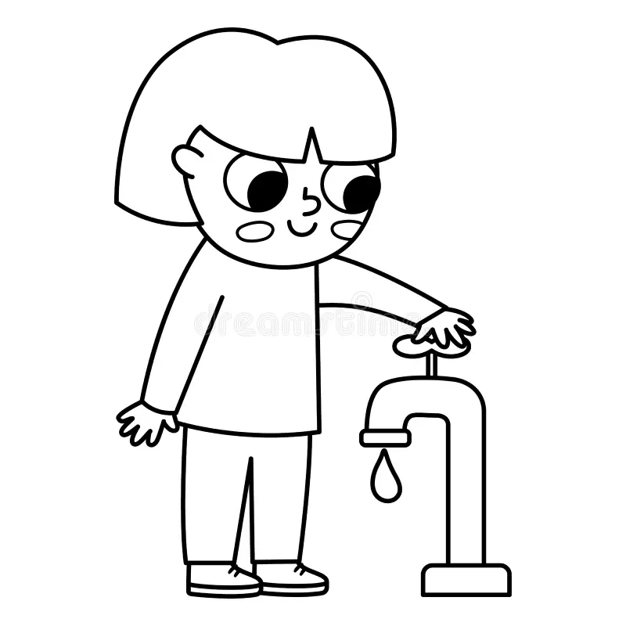
WATER

Slide 8
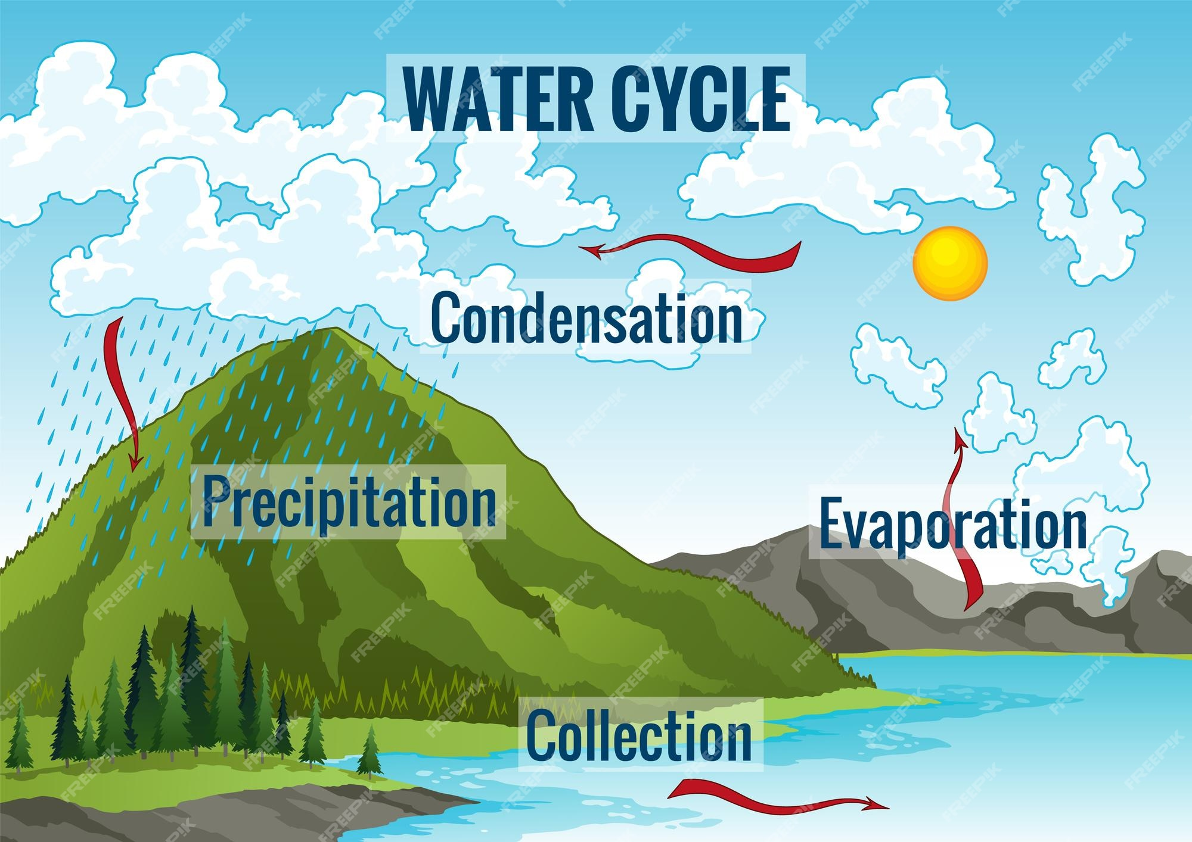
Introduction

Slide 9

Group 1
Colour in the bottle

Slide 10
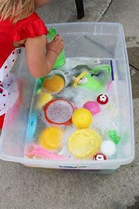
Practical task
HOW TO SAVE WATER

Slide 11

Colour in the picture below

Slide 12
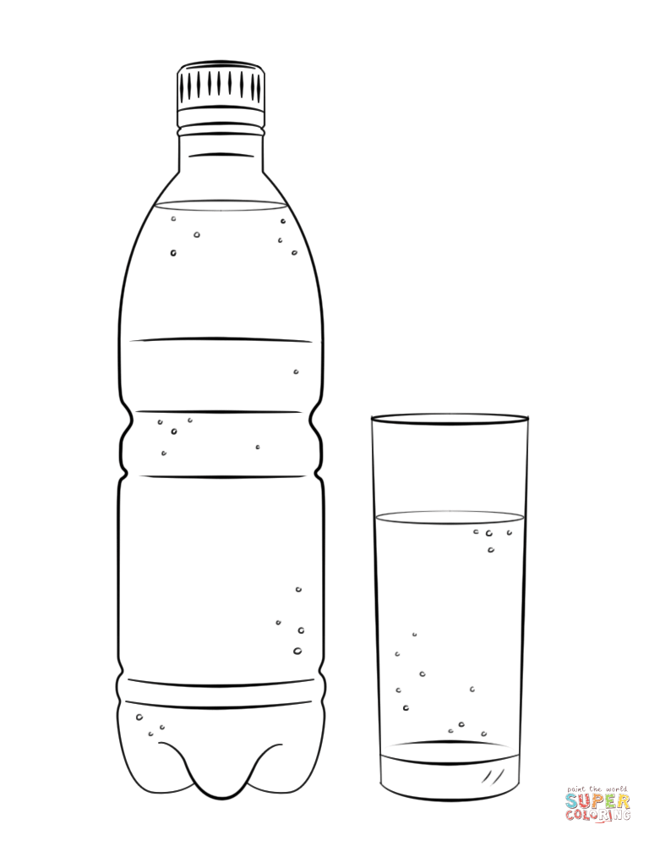
Colour in the water bottle picture below

Slide 13
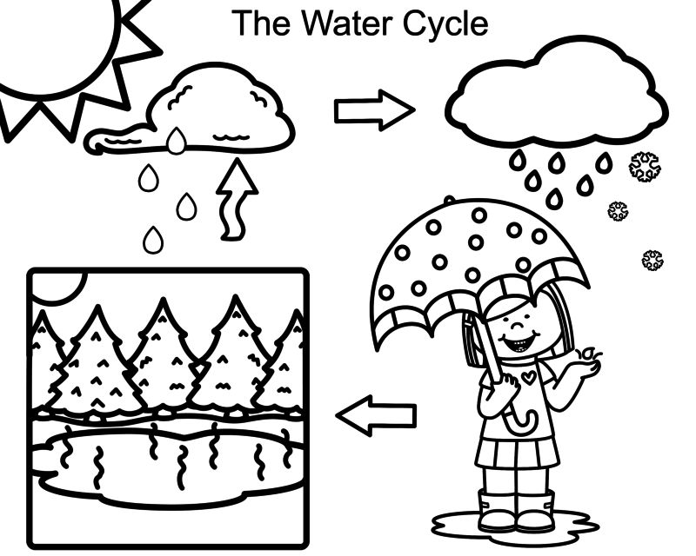
Group 2 water cycle

Slide 14
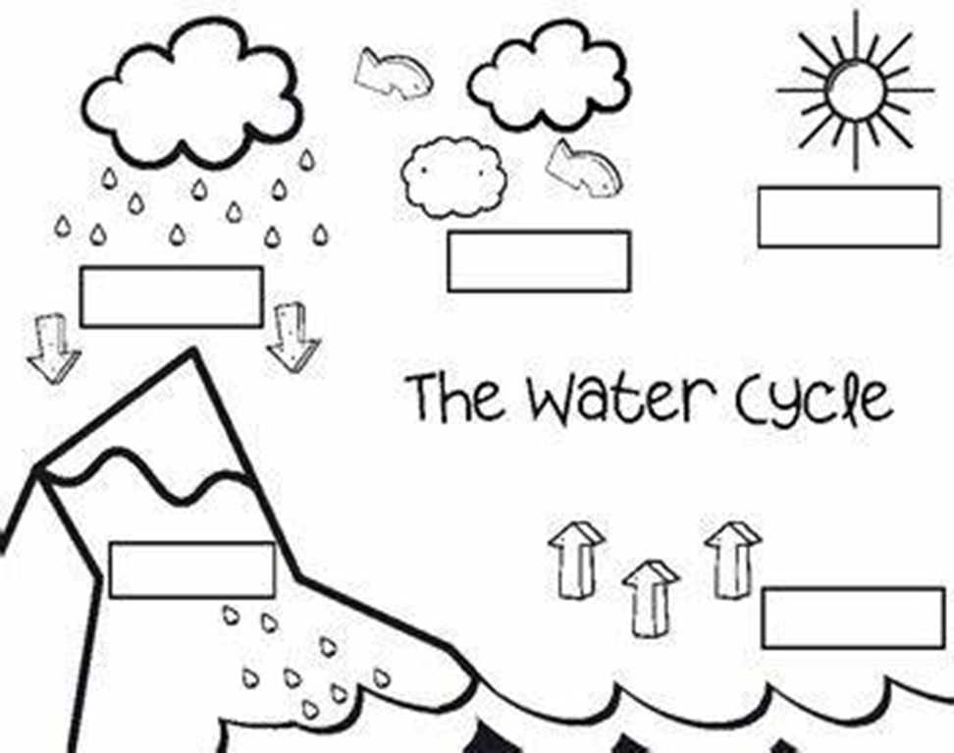
Fill in the water cyle using the following words
condensation | precipitation | Collection | Exploration

Slide 15
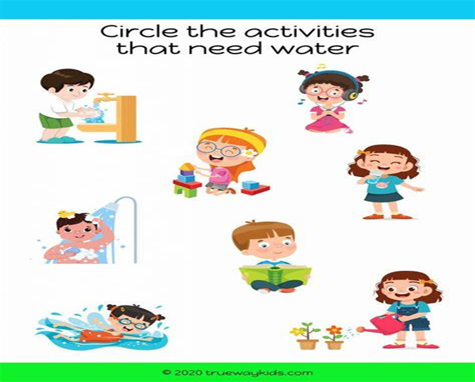

Slide 16
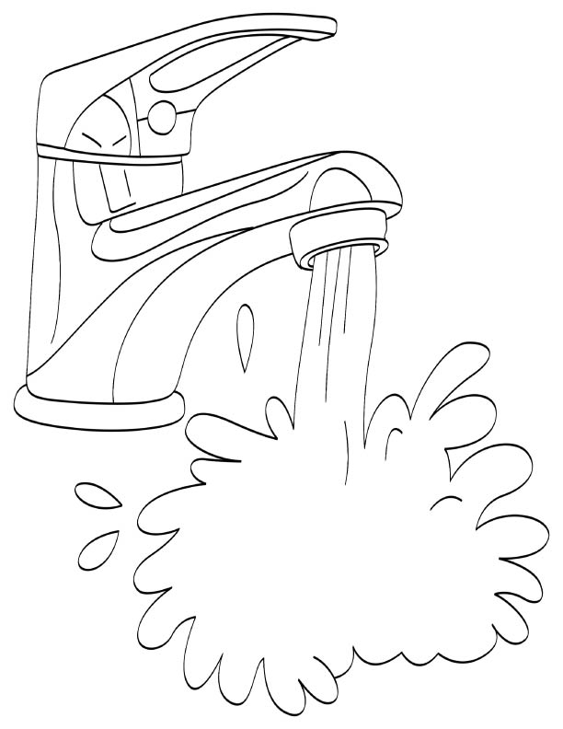
Where do we get water?
Colour the picture below

Slide 17
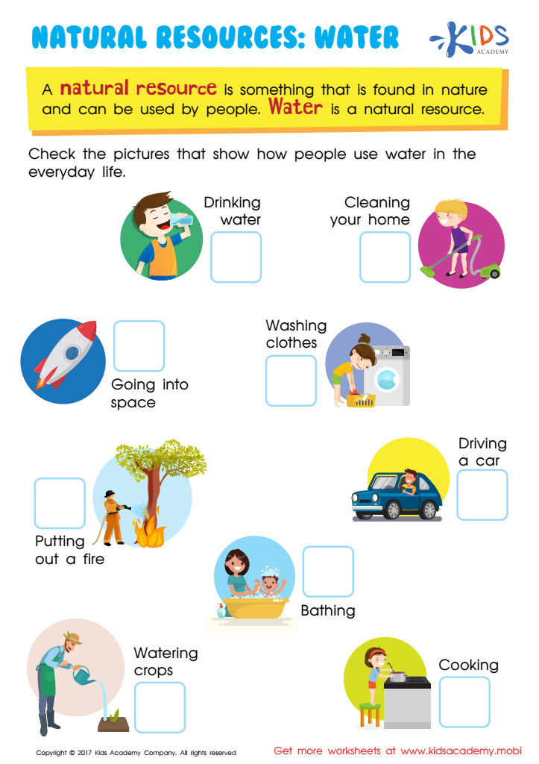
Group 3
Tick the images that shows the ways we use water

Slide 18
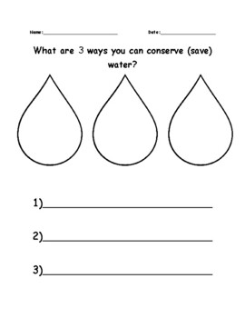
What are the 3 ways you can save water

Slide 19


Slide 20
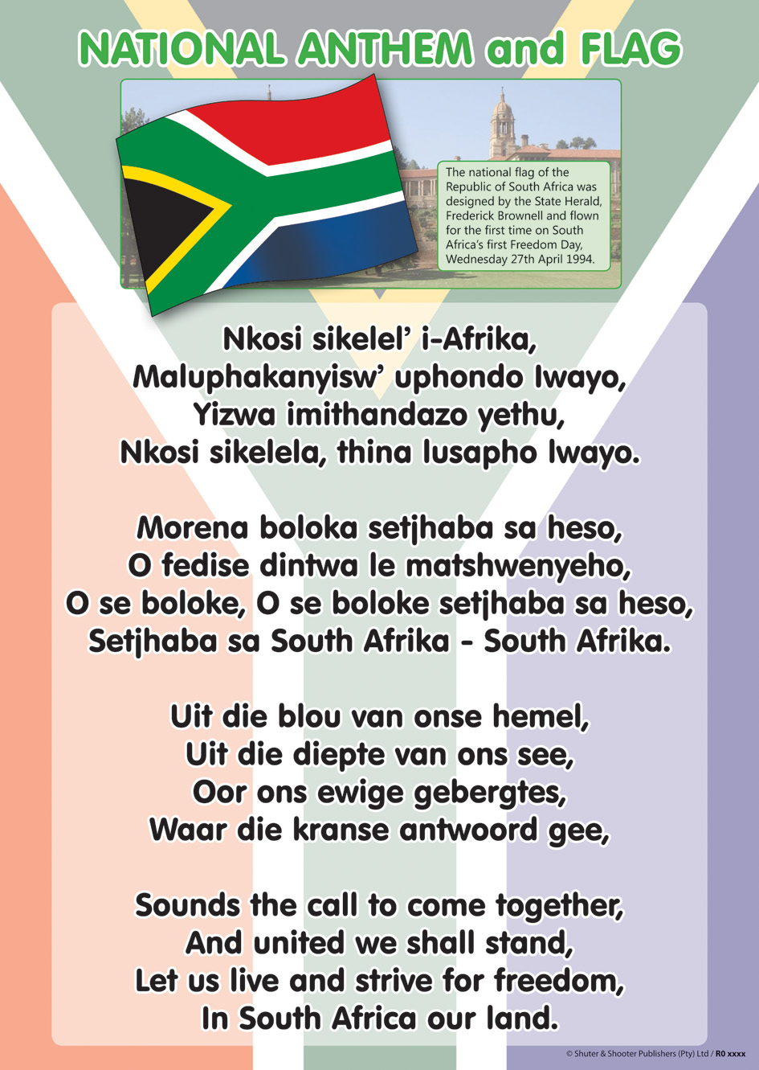
Sing the national anthem

Slide 21

GROUP 1
Colour the South African flag
Colour the South African flag using; black, red, yellow, green, blue and white

Slide 22
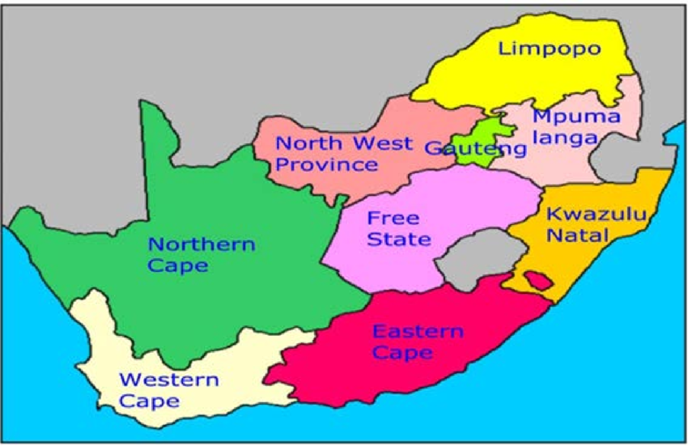
GROUP 2
Point out 9 South African provinces

Slide 23
Sing the national anthem

Slide 24

Trace the words and colour the 6 colours of South African flag

Slide 25
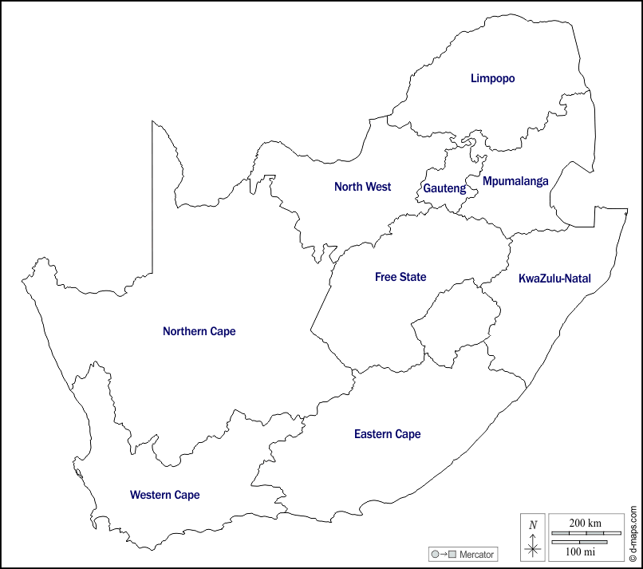
Colour 9 South African provinces

Slide 26
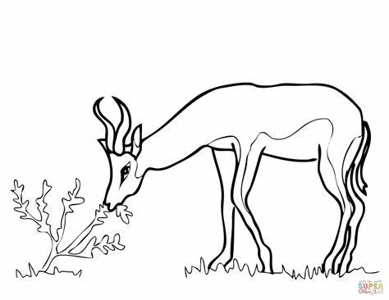
Colour the national springbok

Slide 27

GROUP 3
Colour the South African flag

Slide 28

Colour in the protea national flower using different colours

Slide 29
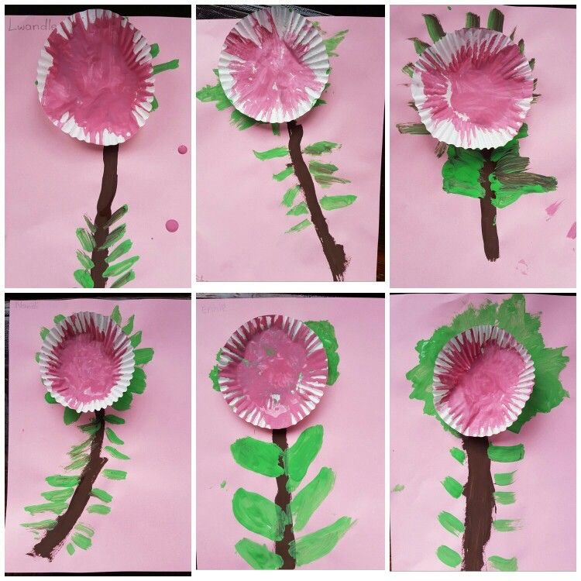
Practical work

Slide 30
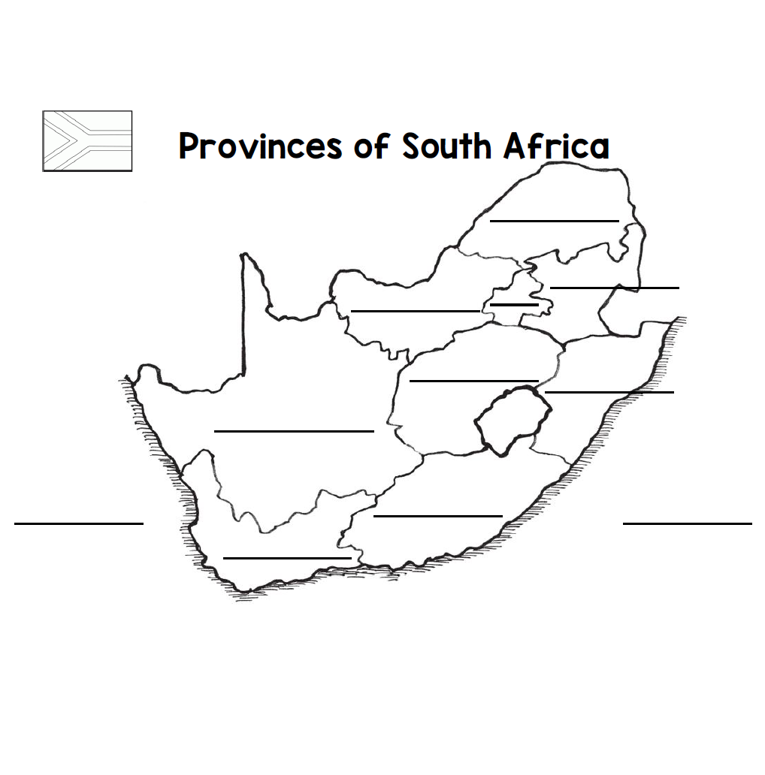
Complete and colour the map

Slide 31
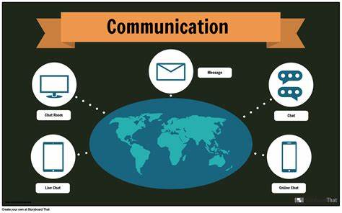
Communication in our world

Slide 32
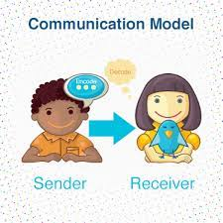

Introduction
What is communication?

Slide 33

Group 1
Colour in the telephone picture

Slide 34
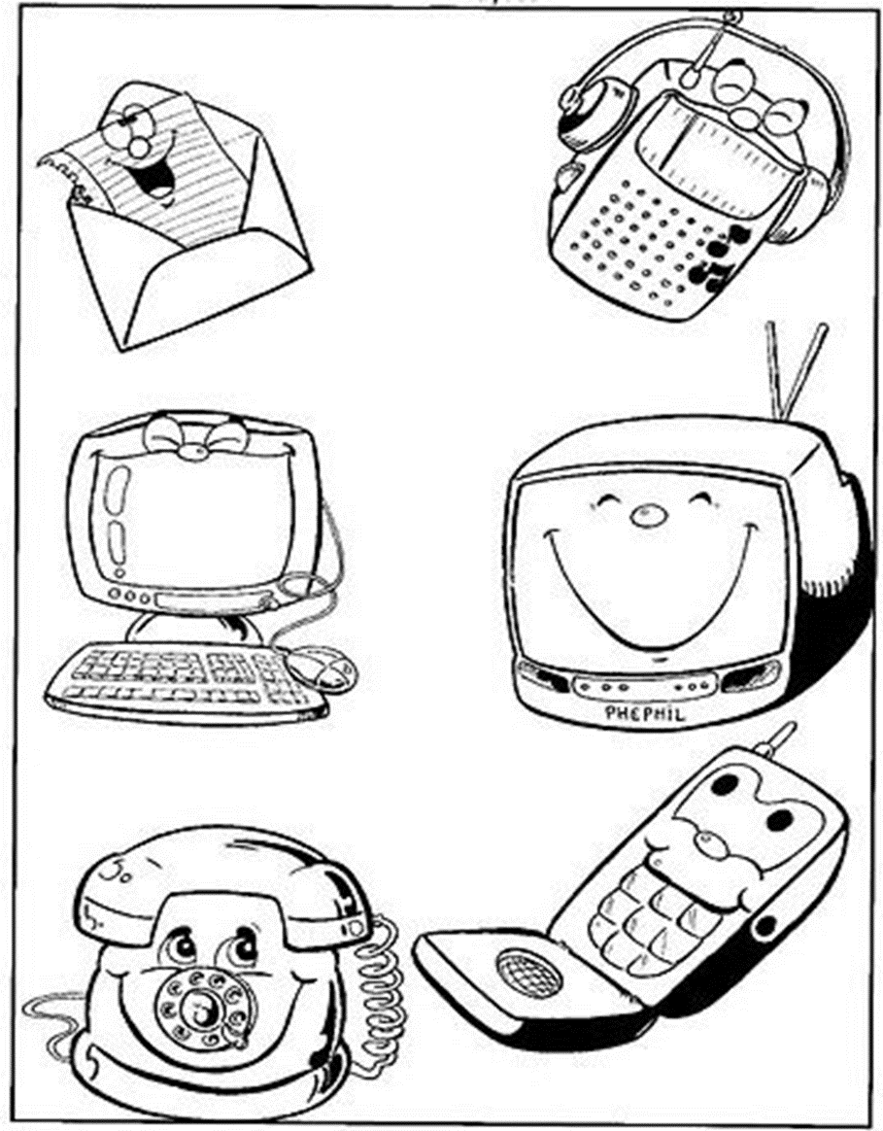
Colour in the picture below

Slide 35
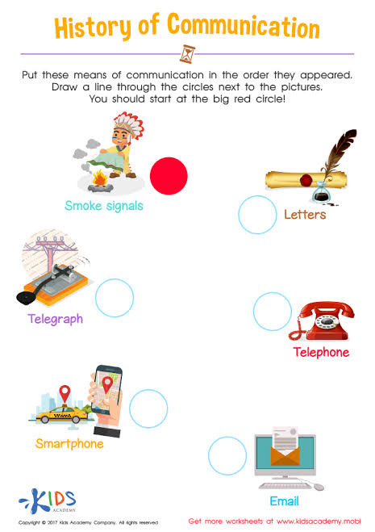
Group 2
Tick the correct form of communication that is used now

Slide 36
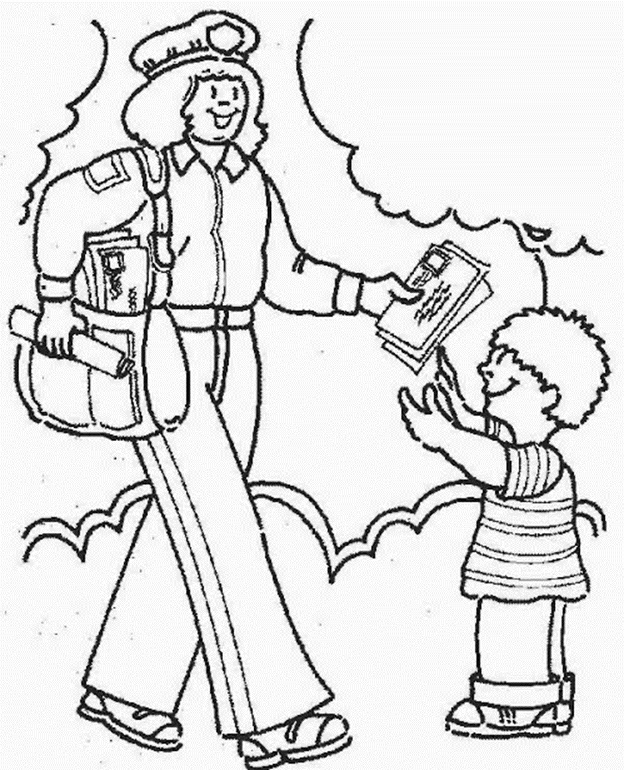
Colour in the mail communication picture below

Slide 37


Slide 38

Group 3
Answer the following questions given in the worksheet on water and its uses:

Slide 39
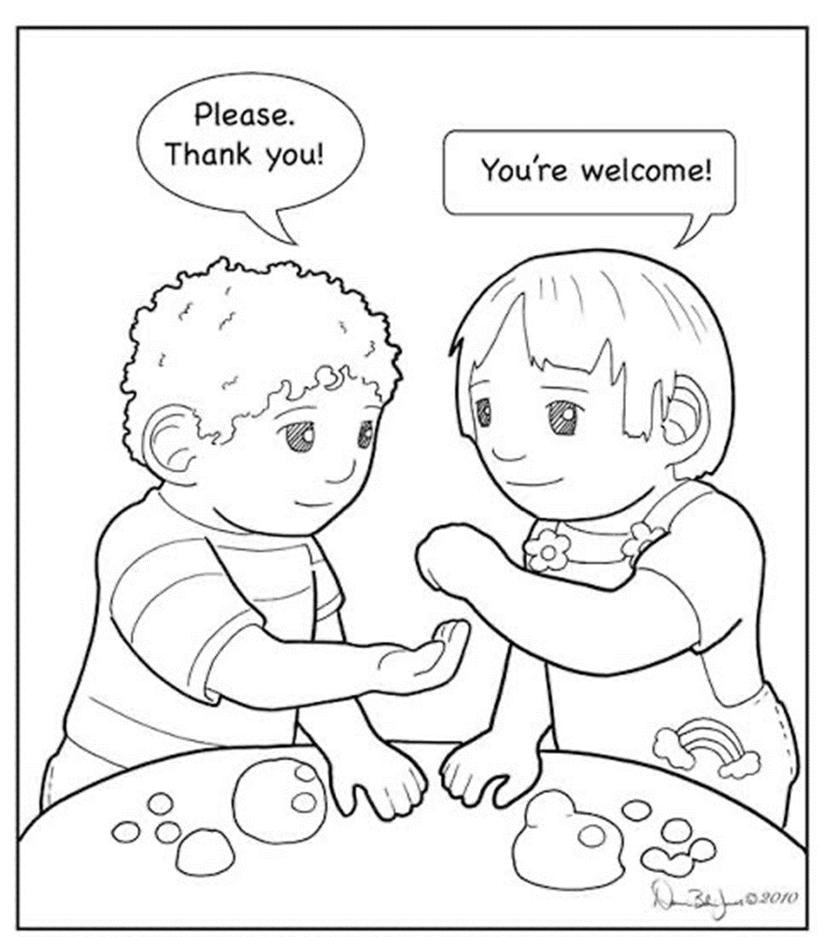
Colour in the picture of verbal communication

Slide 40

Circle the object that we use to communicate

Slide 41
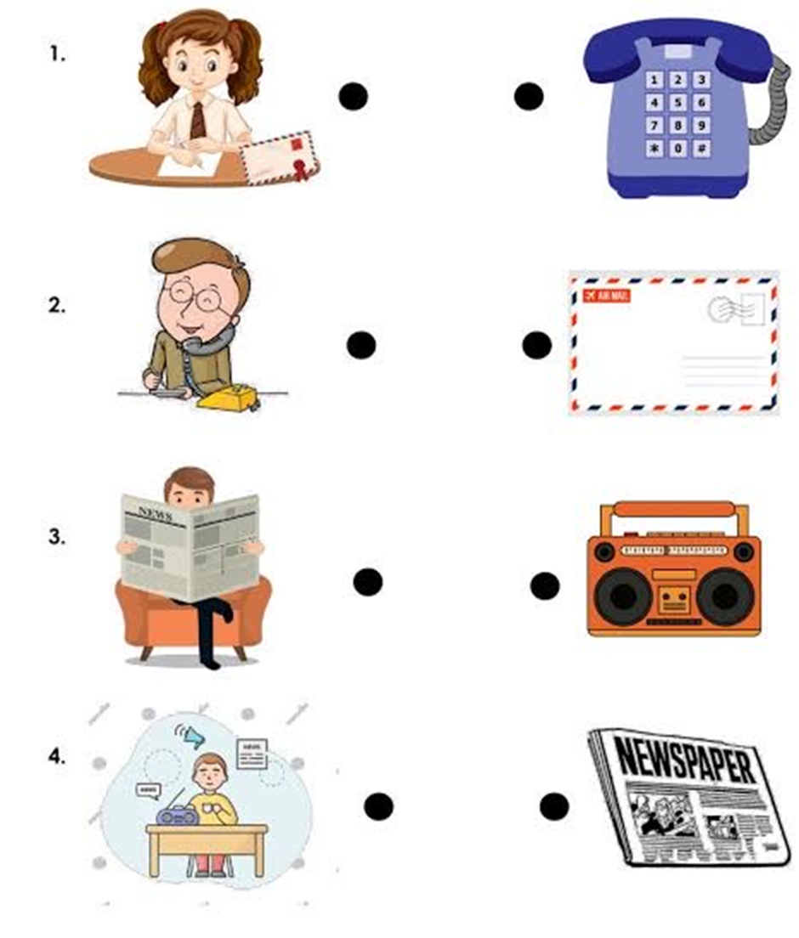
Draw lines to connect the pictures and matching communication tools

Slide 42
Rewrite the following sentences
I can talk on the phone with my friends.
____________________________________________
My father reads the newspaper everyday.
____________________________________________
I love listening to the radio.
____________________________________________
I can chat with my friends on my laptop.
____________________________________________

Slide 43

LIFE AT NIGHT

Slide 44

GROUP 1
Colour in the moon below

Slide 45

Colour in the star picture below

Slide 46

GROUP 2
Colour in the moon picture below

Slide 47

Trace and colour in the moon picture below

Slide 48
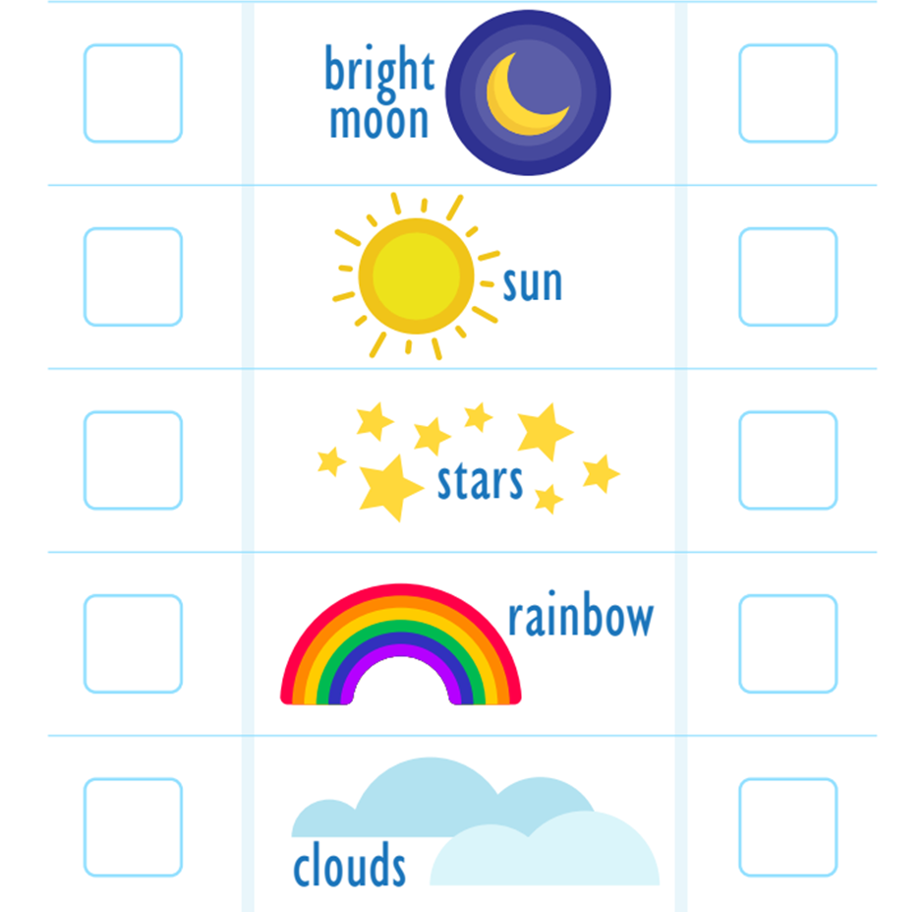
Tick the correct box of what we see at night and during the day

Slide 49
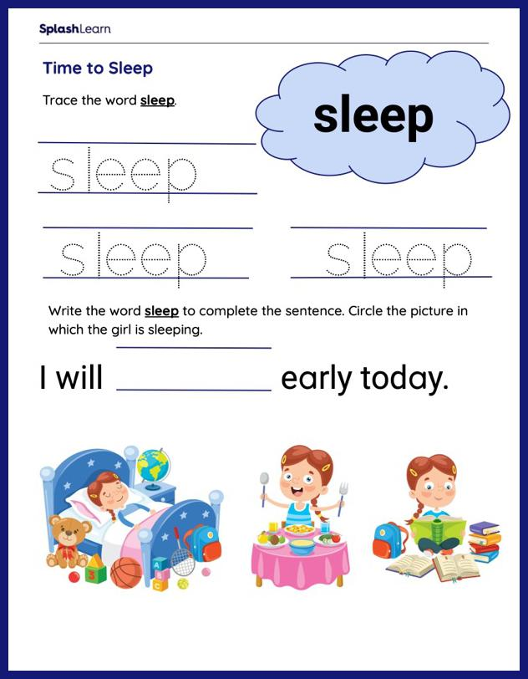

Slide 50
GROUP 3
Draw and colour in any image that represents the night

Slide 51



Colour the images that represent night life

Slide 52
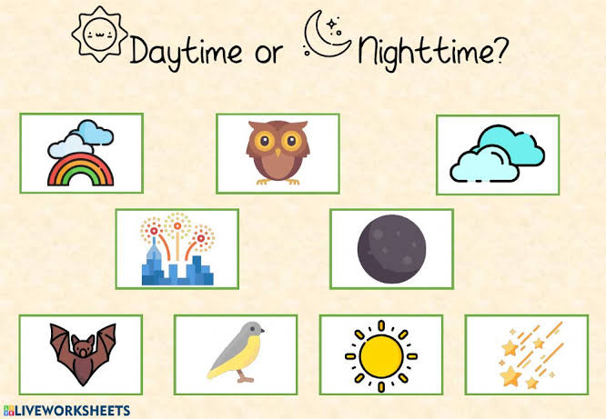
Tick√ the correct picture of night time

Slide 53


Slide 54
Rewrite the following sentences
My favourite time of the night is when I go to sleep
_______________________________________________________________
I do not play with my friends at night.
_______________________________________________________________
My baby brother has peaceful sleep at night.
_______________________________________________________________
My mother works nightshifts at work.
_______________________________________________________________

Slide 55
REFERENCE LIST
https://cdn4.vectorstock.com/i/1000x1000/81/78/transport-cartoons-vector-598178.jpg
https://th.bing.com/th/id/R.4bedde0a34a46c3f8476e8a9c3193ea9?rik=HzmXgDwWSMiEgg&riu=http%3a%2f%2fcdn.turtlediary.com%2fworksheets%2fela%2fpreschool%2fmiscellaneous%2fland-transport-match-the-parts%2fquestion%2fland-transport-match-the-parts-1.png&ehk=QmUIA1EFbE4f0svBv4Cz5sxyTCRyjPK21lGTtr58rpw%3d&risl=&pid=ImgRaw&r=0
https://www.kids-pages.com/folders/worksheets/Transportation/TransportationFillIn.jpg
https://th.bing.com/th/id/OIP.fRSAqPJELZxVQ3CRL-bfpgAAAA?rs=1&pid=ImgDetMain
https://th.bing.com/th/id/OIP.j1aGQgbLnwFPQ_I9JjVwygHaKe?w=178&h=252&c=7&r=0&o=5&pid=1.7
https://th.bing.com/th/id/OIP.sfoXR83NPVP-oQz6Fw5fKgAAAA?w=178&h=241&c=7&r=0&o=5&pid=1.7
https://th.bing.com/th/id/OIP.Nf6VTxle16YtwHqxzvj24QAAAA?rs=1&pid=ImgDetMain
https://th.bing.com/th/id/OIP.G22CAwskSgcV--pN-tS4-gAAAA?rs=1&pid=ImgDetMain

